Slide 1




AI-POWERED LEGAL DOCUMENTATION ASSISTANT
Lexaido.ai

Slide 2




AI-POWERED LEGAL DOCUMENTATION ASSISTANT
-- Revolutionizing the Legal Landscape
Guide Name : Prof. Shreela Pareek
Team :
Mradul Tayal - 2100290120108-8B Priyanshu Bharadwaj - 2100290120130-8B Dhruv Sharma - 2100290120073-8B
Kirti Singh - 2100290120097-8B
Project ID : PCS25-02

Slide 3




Problem Statement
Complexity: Legal jargon makes document review difficult.
Time-Consuming: Lawyers spend hours reviewing and drafting contracts.
Error-Prone: Manual processes increase the risk of mistakes.
Compliance Issues: Keeping up with regulations is challenging

Slide 4



Objectives
Assess past legal cases and predict possible outcomes
Assist users with legal issues by offering insights
Generate legal documentation With the least manual effort.

Slide 5
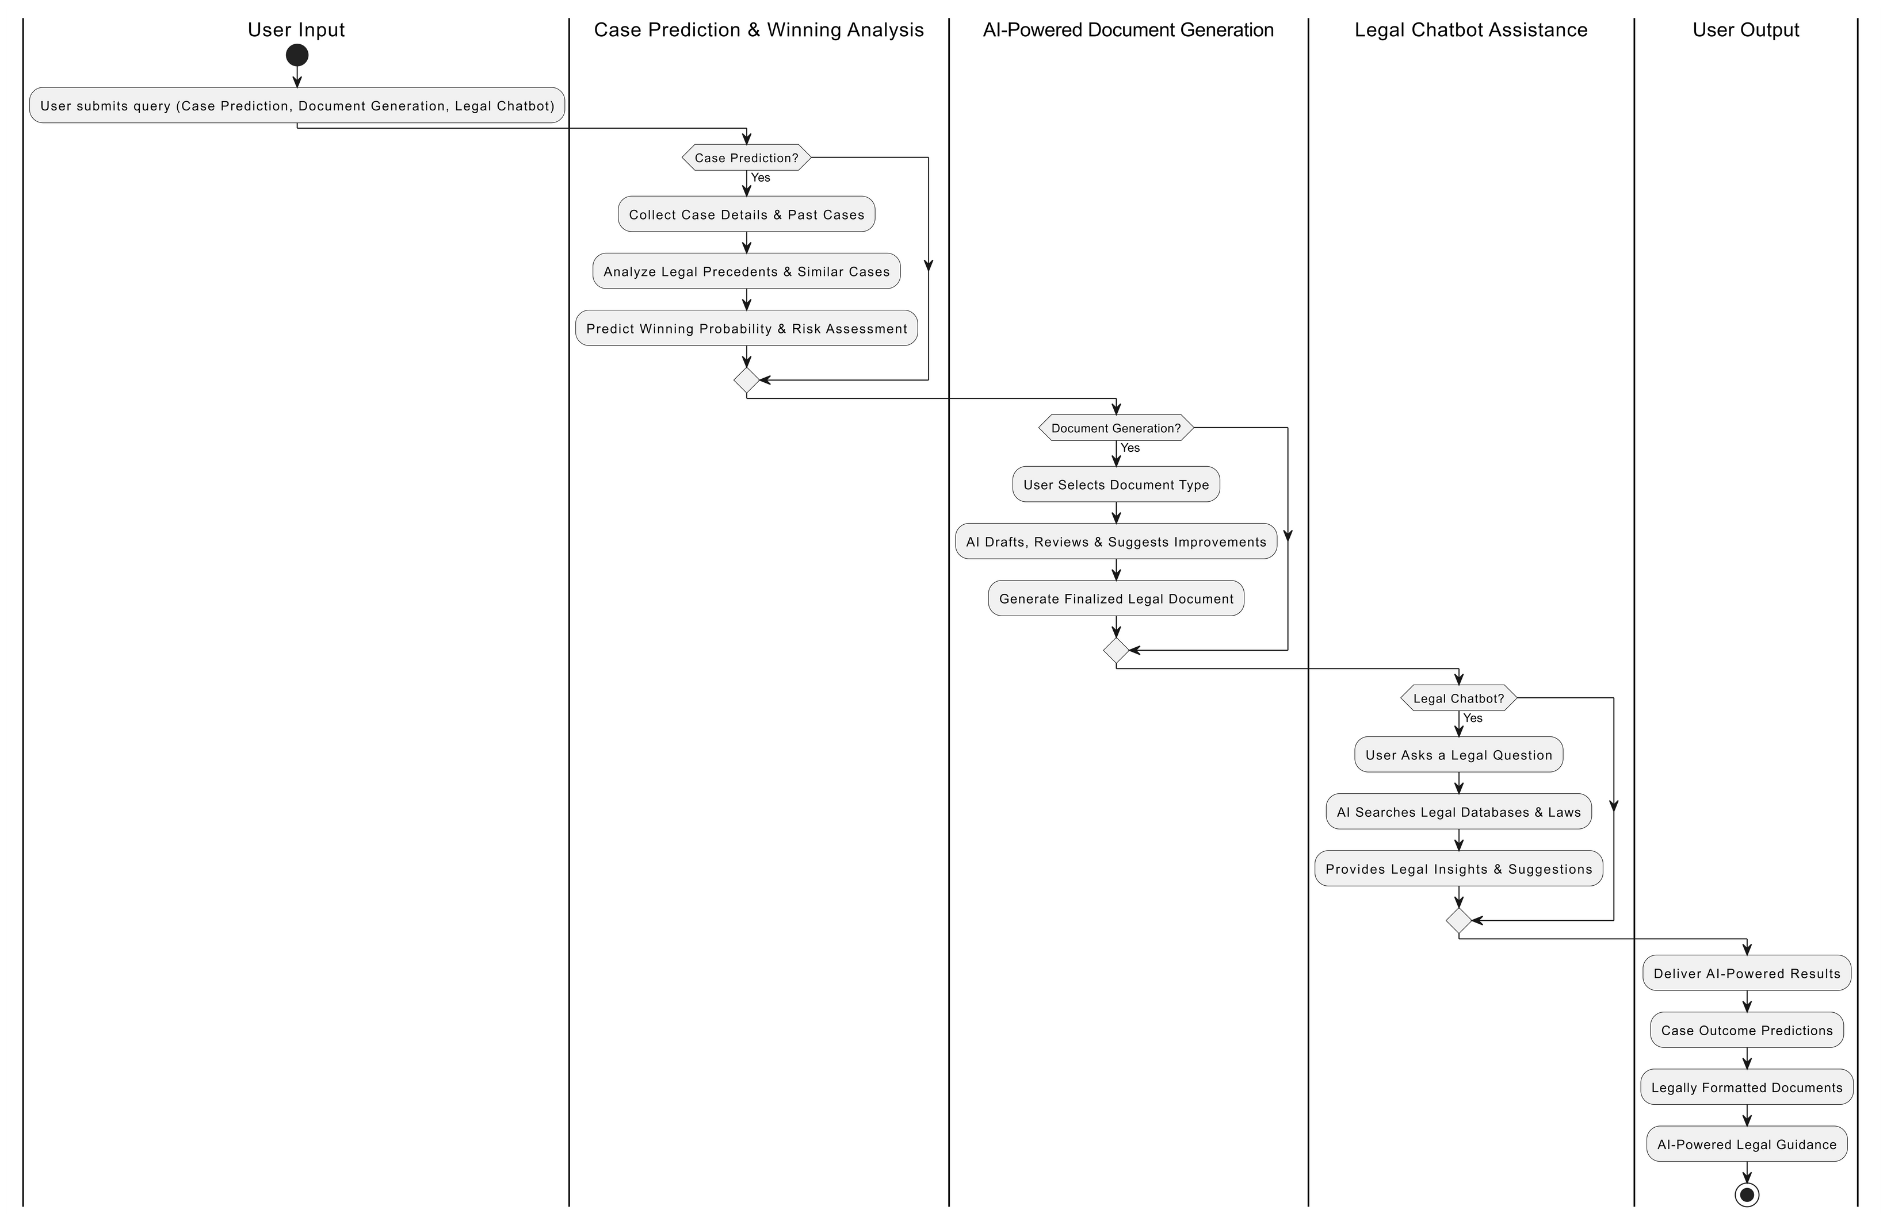

Slide 6



Patent Published
PROJECT STATUS
Research paper Communicated
Frontend and designing Done
3 Modules completed

Slide 7


SDG MAPPING
SDG 9 : Industry, Innovation, and Infrastructure
SDG 8: Decent Work and Economic Growth
SDG 16: Peace, Justice, and Strong Institutions
SDG 4: Quality Education
SDG 10: Reduced Inequalities

Slide 8

REFERENCES
Katz, D. M. et al. (2017). "Predicting Supreme Court Decisions." PLoS ONE.
Chalkidis, I. (2020). "Legal-BERT: A NLP Model for Legal Text." EMNLP.
LawGeex. (2018). "AI vs. Lawyers in Contract Review." LawGeex Report.
Susskind, R. (2020). Online Courts and the Future of Justice. Oxford University Press.

Slide 9
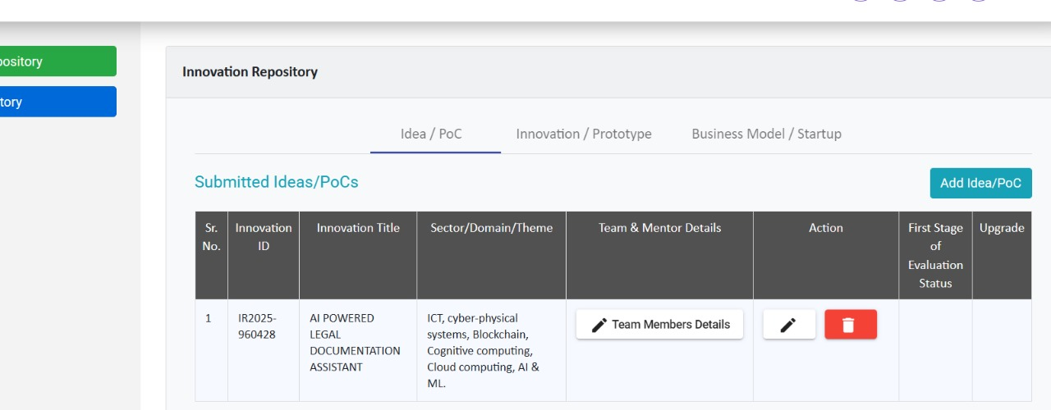

Slide 10
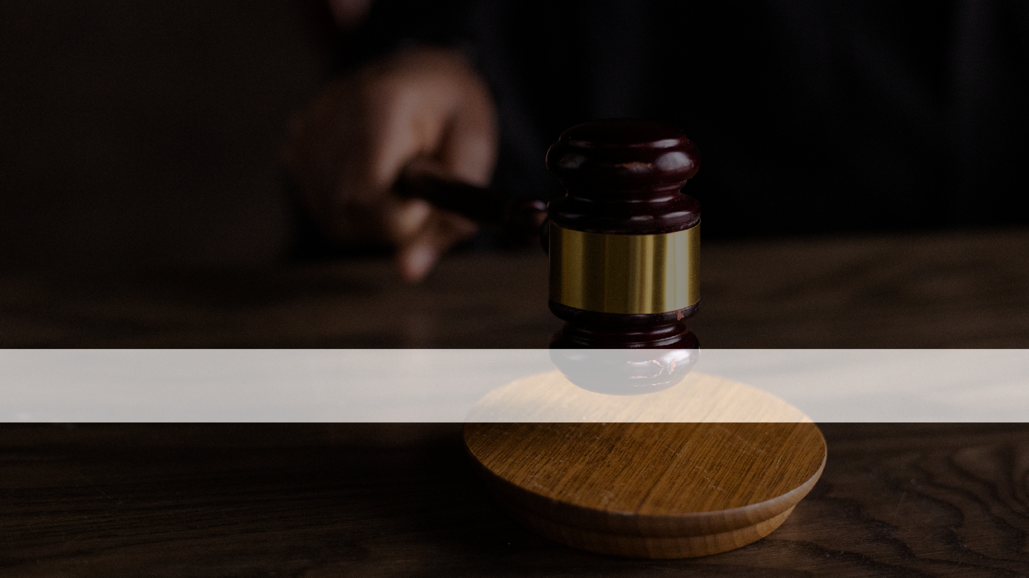

THANK YOU!
Thank you for exploring the vital role of AI in simplifying legal processes

